Slide 1

True or False
A series of statements will be asked. You will be given a short amount of time to decide whether the statement is true or false and hold up your answers.

Slide 2
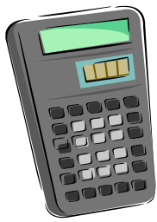
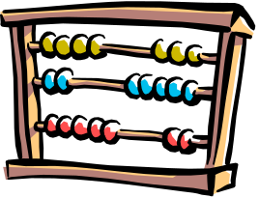
Scientific Notation
24 000 000 is written as 2.4×10⁷
1 000 000 000 is written as 1×10⁹
35 000 is written as 35 ×10³
17 is written as 1.7 ×10¹
6 can be written as 6 ×10⁰
0.000 38 is written as 3.8 ×10⁻⁴
0.000 007 5 is written as 75 ×10⁵
0 = 10⁰
1 ×10⁴ is equal to one thousand
1 ×10⁻⁶ is equal to one millionth
T
T
F
T
T
T
F
F
F
T

